Slide 1
Muse-CAR ASTE dataset

Slide 2
Highlights
A new benchmark dataset for Aspect Sentiment Triplet Extraction.
First Aspect Sentiment Triplet Extraction (ASTE) Dataset in Automotive Domain.
Largest ASTE Dataset to date with annotations for over 28,295 sentences.
Dataset includes complex aspects not verbatim present in the sentence.
Domain: Aspect-based sentiment analysis, ASTE, Opinion Mining, Recommender System.

Slide 3
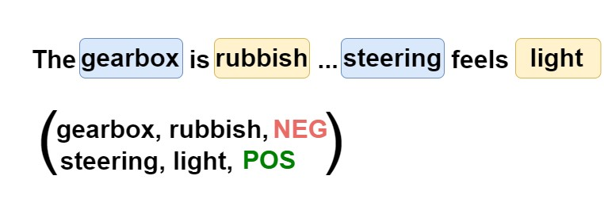
Aspect Sentiment Triplet Extraction
Challenges:
i)learning the association between aspect target extraction, and opinion target extraction,
ii) learning the complex relationship between aspects and opinions
– one-to-many, many-to-one, overlapped, and embedded,
iii) extracting multiple sentiments, aspects, and opinions in a single sentence,
iv) extracting multiword aspects and opinions,
v) handling vague natural language and extract aspects not directly verbatim

Slide 4
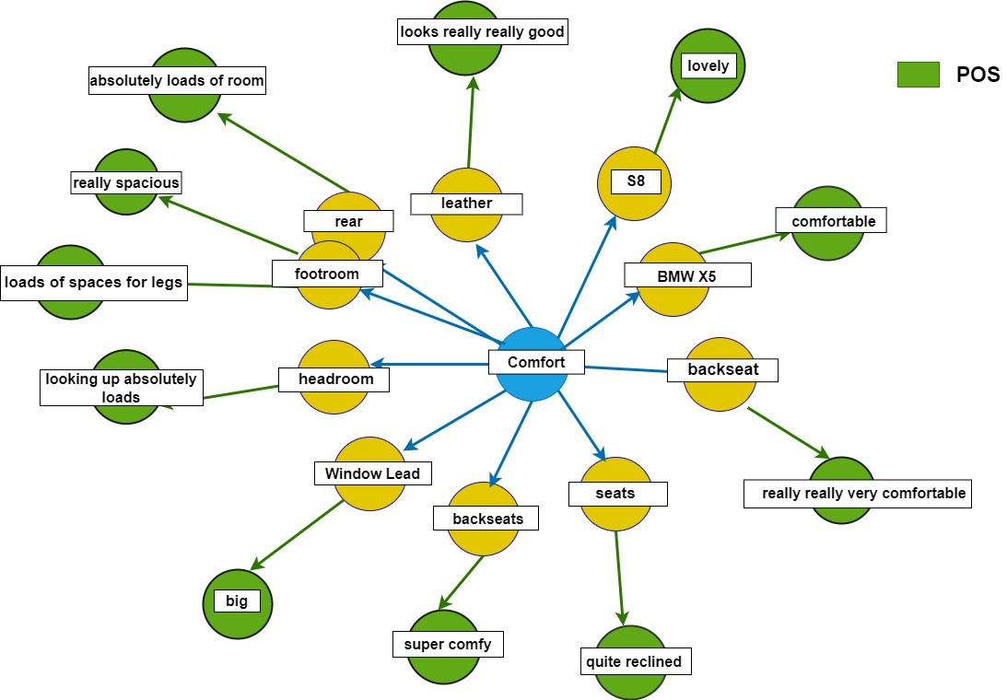

Slide 5
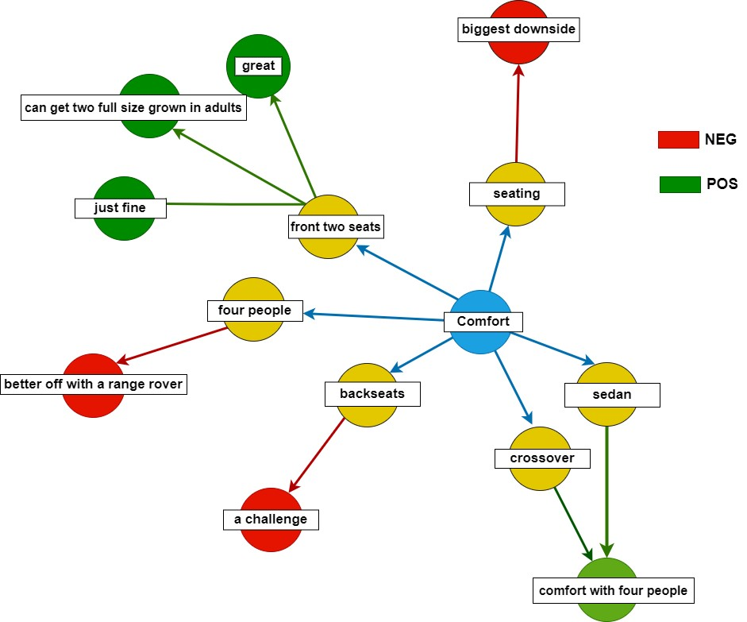

Slide 6
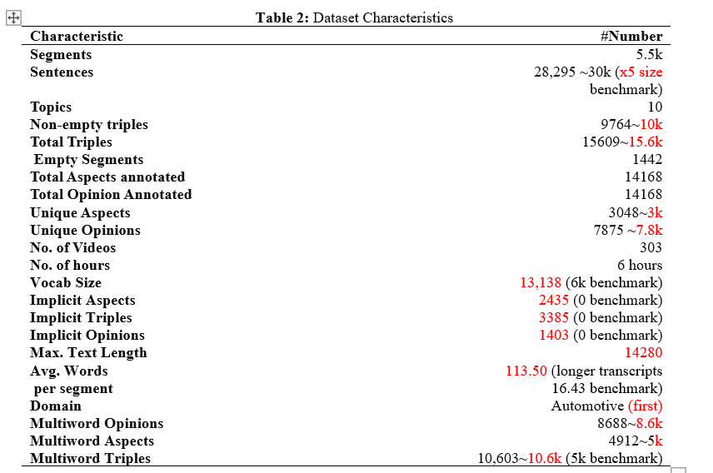

Slide 10
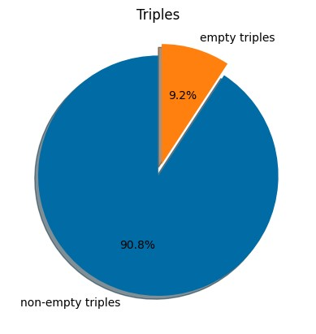
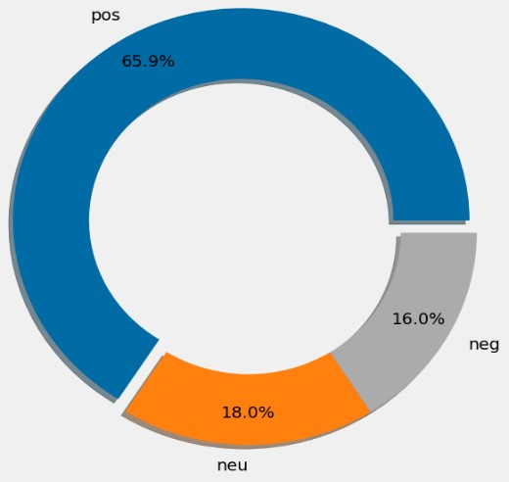
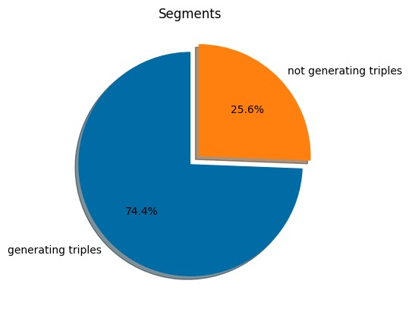
Data Distribution

Slide 11
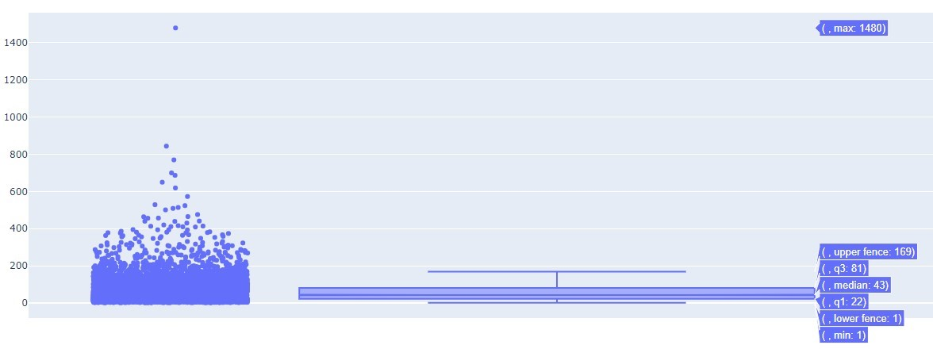
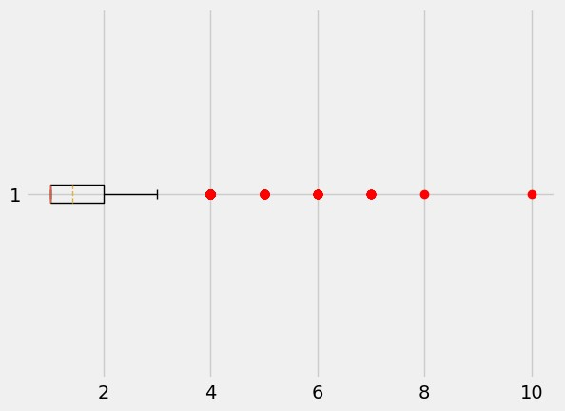
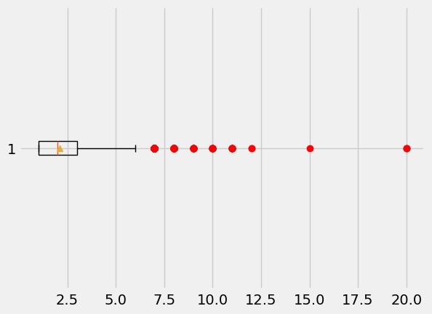
Box plot of Lengths

Slide 12
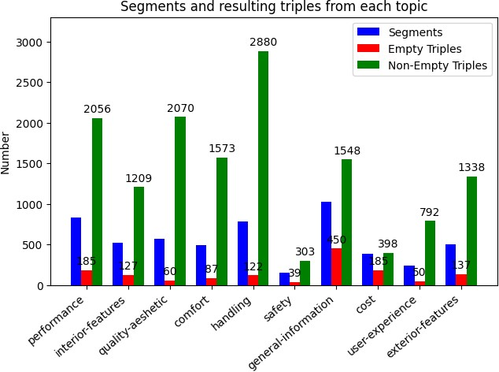
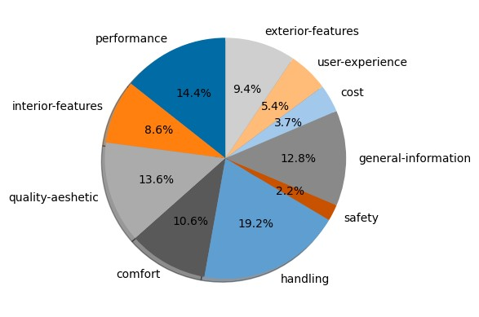

Slide 13

Dataset Creation

Slide 14
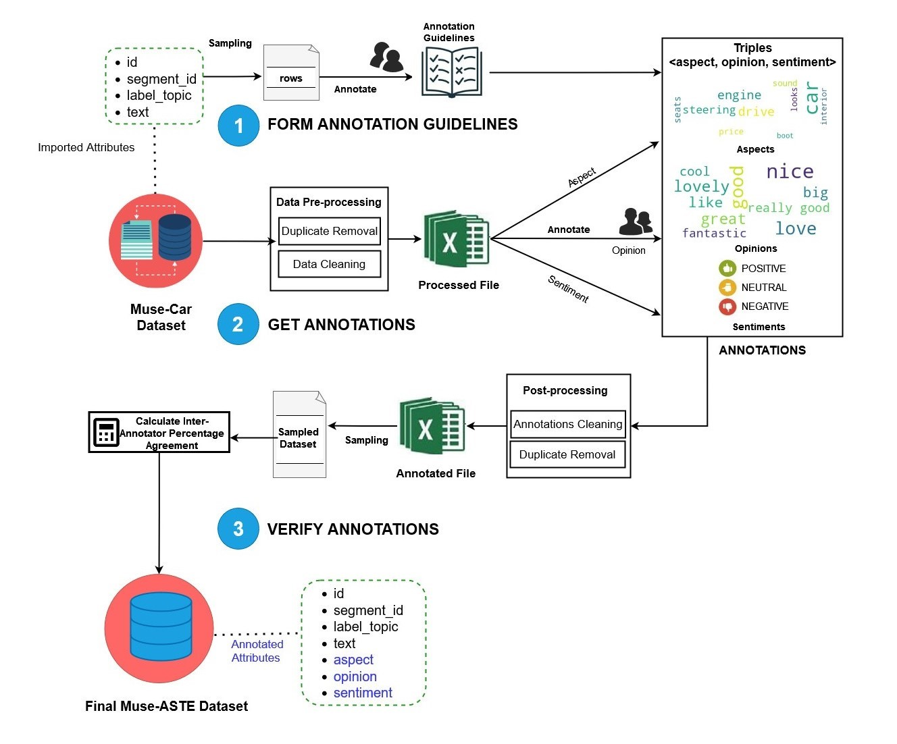

Slide 16
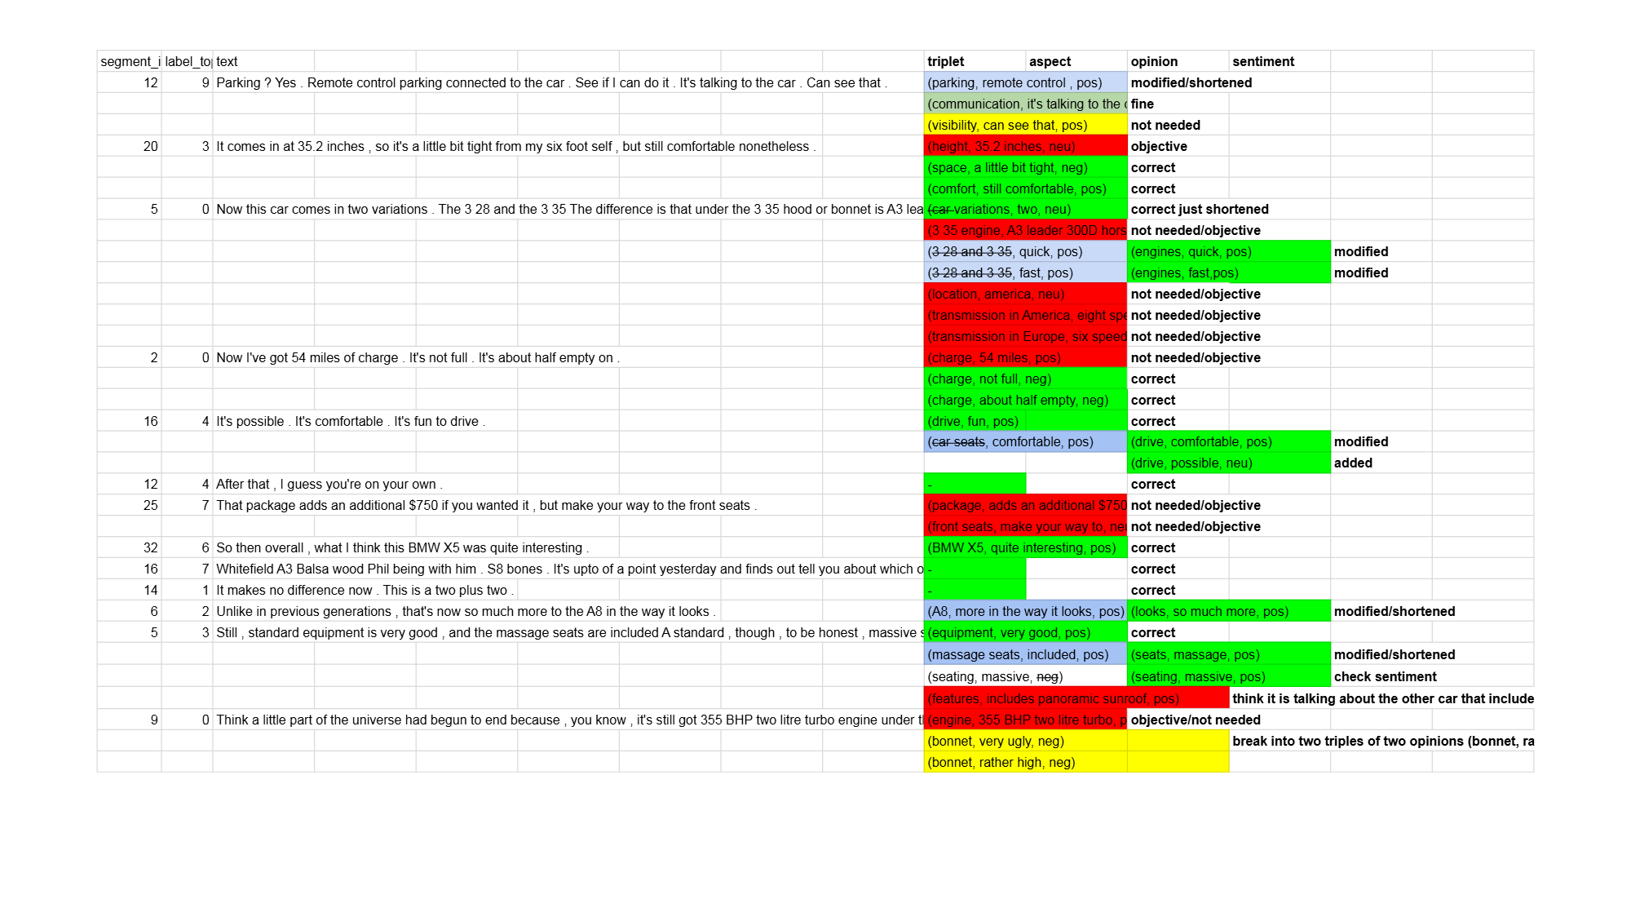
Annotator Feedback

Slide 17
Annotation Guidelines
extract all aspects for the segment – one triplet per row
split multiple opinions into triplets like “drive nice and fun -> (drive,nice,pos), (drive, fun, pos)
do not extract unrelated subjective/objective information not talking about the entity line “enjoyed the video” should result in <-,-,->
implicit aspects are extracted. "car is low to the ground"–> (height, low, neu)
use the same text as present in the original review segment
shorten it as much as possible
vi) use common sense from the customer point of view for marking correct sentiment like high price is negative, or having a large boot is the car is positive, small windows is negative because visibility will be less
vii) i spelling errors in the text transcripts, correct them and extract

Slide 19
Inter-Annotator-Agreement
No. of agreeingtriples > τ

Slide 21

Statistical Annotation Analysis

Slide 22
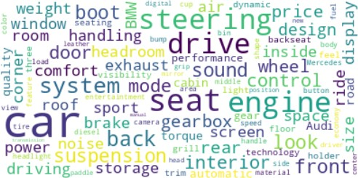
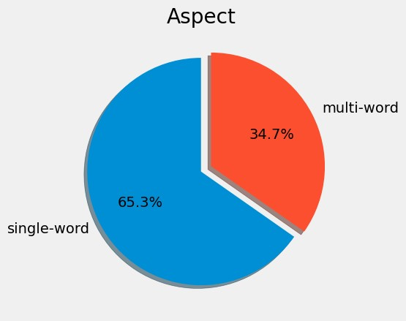
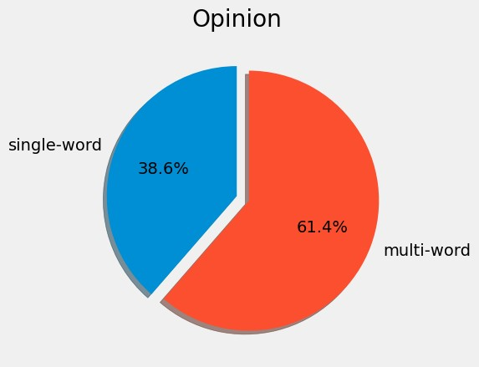

Slide 25
Baseline Models

Slide 26
Generative-ABSA. (Zhang et al., 2021)
generation-based framework
extraction paradigm [(triple₁); (triple₂) …; (triple _{k})], where k=no. of triples the segment generates.
triple consists of (aspect a, opinion o, sentiment p).
final target representation for each segment is [(a₁, o₁, s₁); (a₂, o₂, s₂) ….; (a_{k}, o_{k}, s_{k})].
fine-tune the pre-trained T5 model (Raffel et al.,2020) on our dataset.
BMRC
The model (Chen et al., 2021) uses machine comprehension
BERT for encoding.
two binary classifiers: aspect-oriented, and opinion-oriented to identify these spans, which are then merged to get the result
Sentiment is inferred from the CLS token.
BART-ABSA
(Yan et al., 2021) is a pointer-based generation method
generates indices of aspect term, opinion term and classifier.
SPAN-ASTE
tagging-based method predicting whole spans of targets and opinions. (Xu et al., 2021)

Slide 27
Results

Slide 28
Results-processed Dataset

Slide 29
Comparison with our dataset

Slide 30
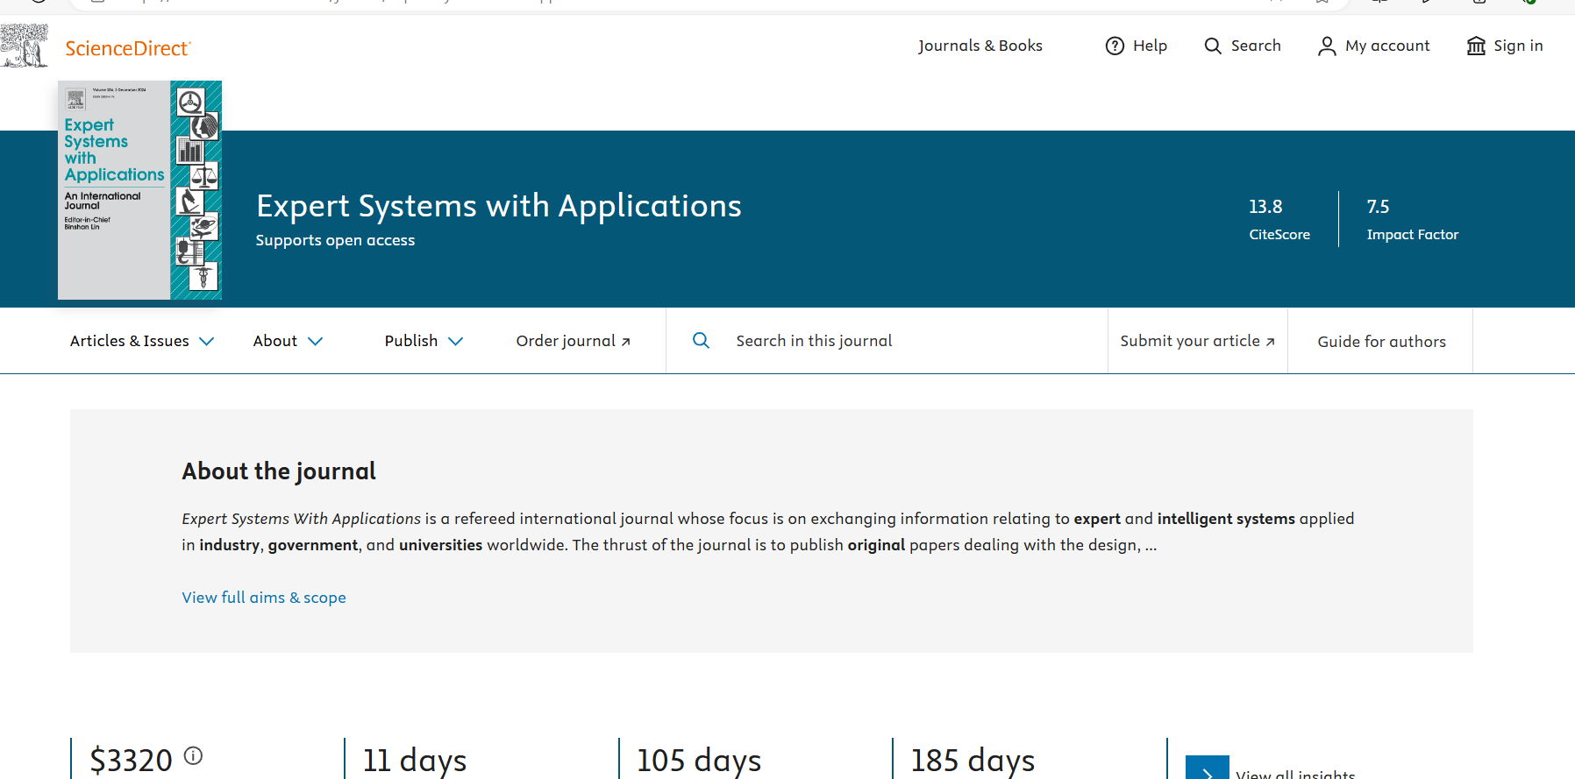

Slide 31
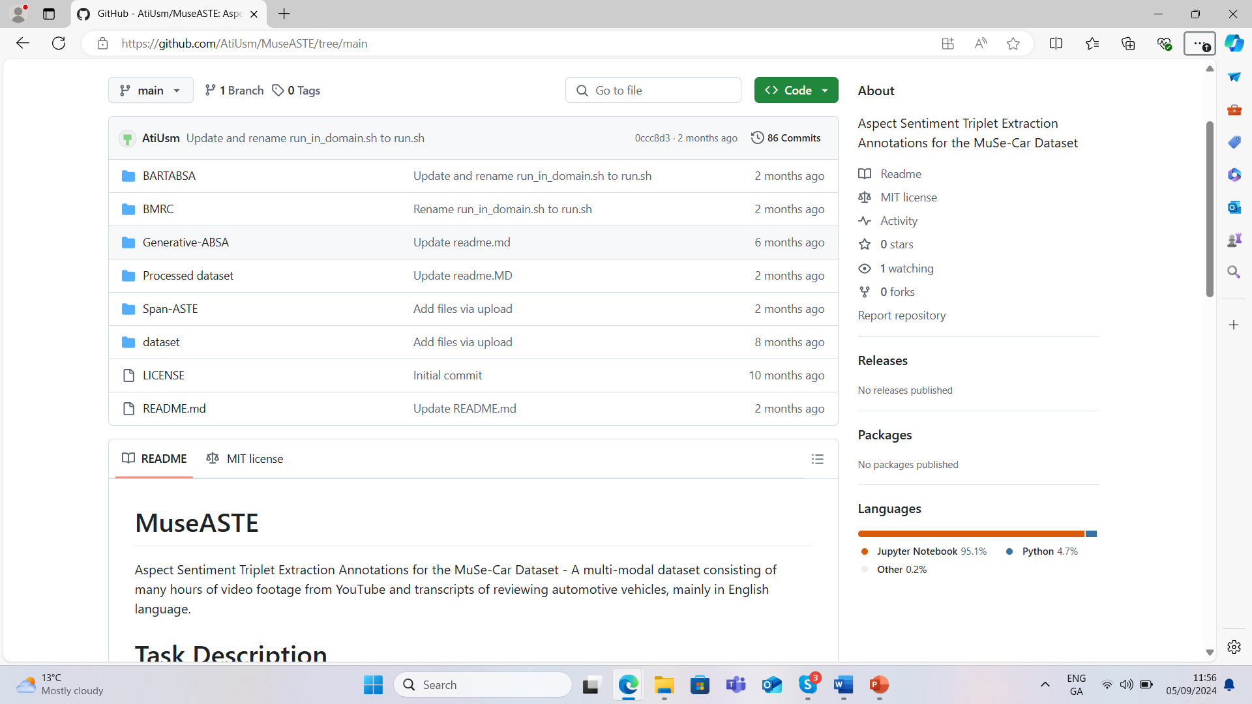
GitHub - AtiUsm/MuseASTE: Aspect Sentiment Triplet Extraction Annotations for the MuSe-Car Dataset

